Slide 1
PG ROOMS MANAGEMENT
NAME:NOUSEED SHAIKH
REG.NO:U02BF22S0109

Slide 2
OBJECTIVES
Develop user friendly web application for managing PG Rooms.
Provide a platform to PG Room Owners to showcase their properties.
Enables users to search and apply for PG Rooms efficiently.
Streamline the application for both users and owners.

Slide 3
TOOLS /PLATFORMS AND LANGUAGES TO BE USED
HARDWARE REQUIREMENTS
Processor : Core i3 intel processor
RAM : 2 GB And above
Hard Disk : 20 GB
Operating system: windows 7 and above

Slide 4
SOFTWARE REQUIREMENTS
Frontend : HTML,CSS
Middle ware : PHP
Backend : MYSQL

Slide 5
LIMITATIONS
Dependence on Internet connectivity.
Dependence on user feedback and ratings.
Limited integration with external services.

Slide 6
SCOPE OF THE PROJECT
Development of Android and IOS application.
Integration with payment gateways.
Advanced search filters.
Review and Rating System.

Slide 7
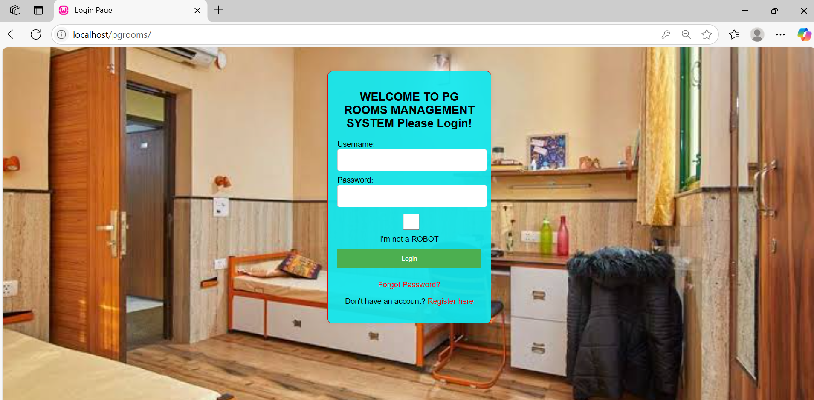
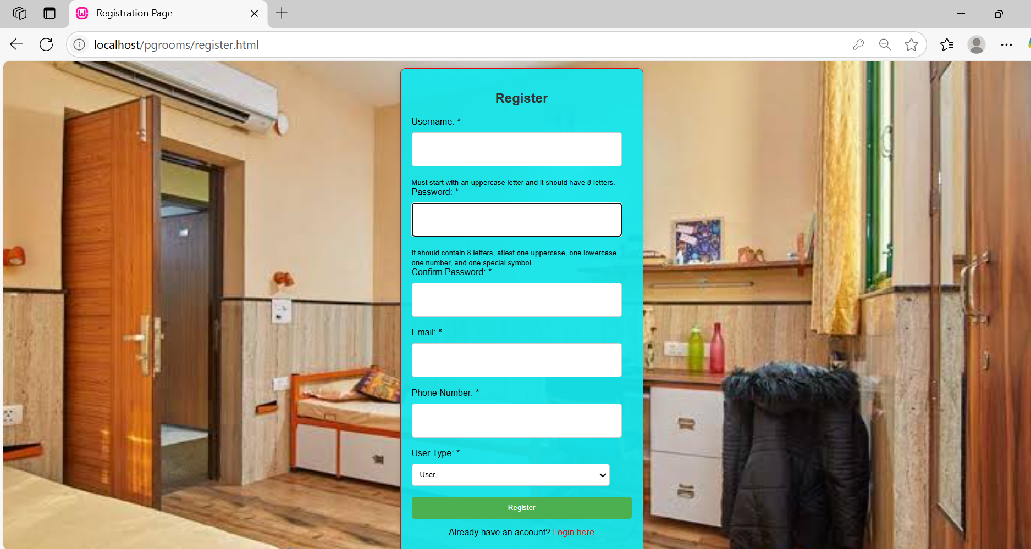
SCREEN SHOTS
LOGIN FORM
REGISTRATION FORM

Slide 8
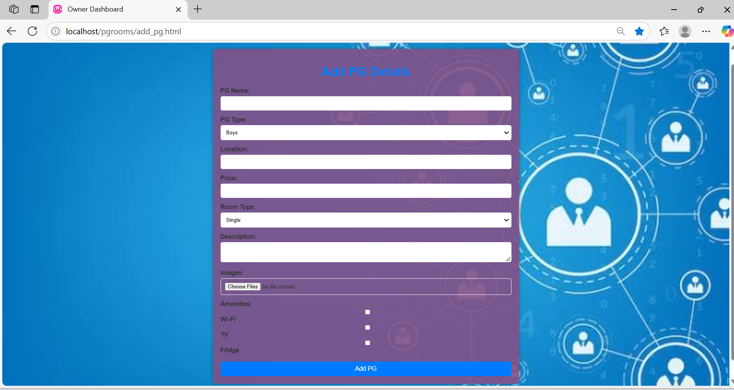
OWNER DASHBOARD
Here Owner will add the PG

Slide 9
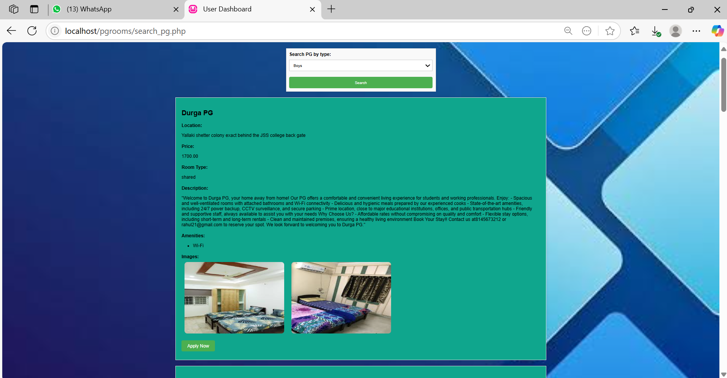
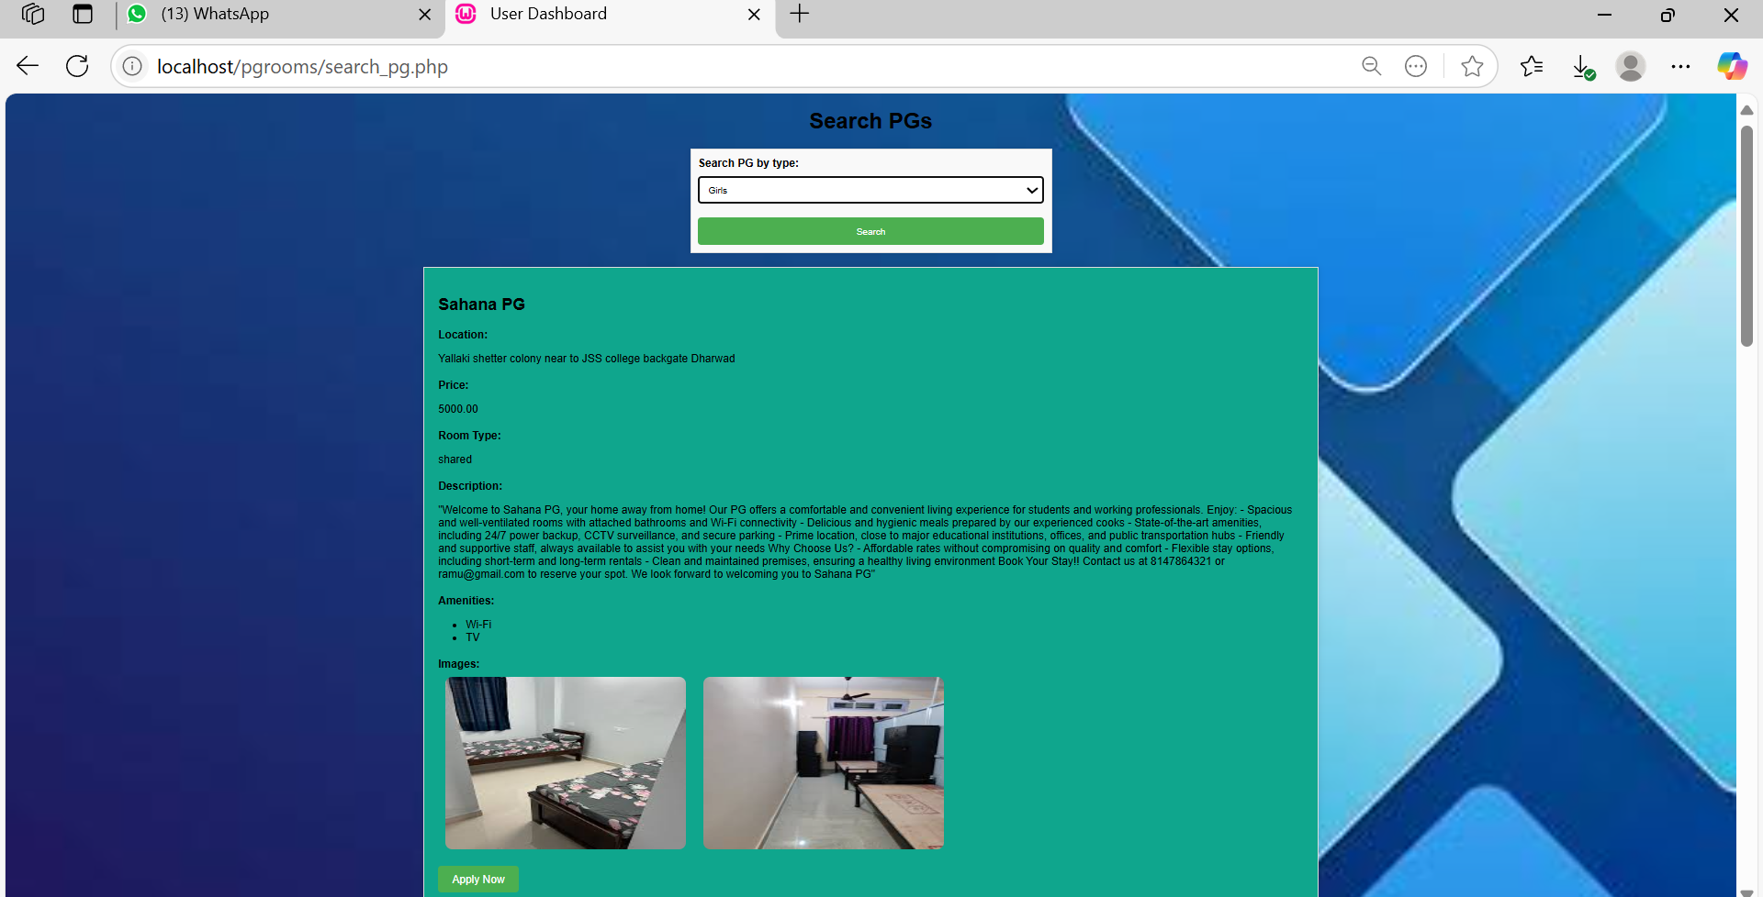
USER DASHBOARD
BOYS
GIRLS
When the particular user searches for PGs according to his type whether it is Girls PG or Boys PG.

Slide 10
THANK YOU

